Slide 1
2020 Computer Architecture Project
배한준
qwerty2901@korea.ac.kr
공학관 236호

Slide 2
Project
Main Purpose of this Project
Understand MIPS assembly language and Recursive Function algorithm
QtSpim
It reads and executes assembly language programs
It contains a simple debugger
Using this program, it’s possible to run a MIPS assembly code
Download Link
https://sourceforge.net/projects/spimsimulator/files/
You can download the latest version for your operating system.
You can use developer guide documents in reference folder
MIPStestSMv11.pdf
QtSpim-User-Manual-Final-Draft.pdf
Due Date : 2020. 6. 5.

Slide 3
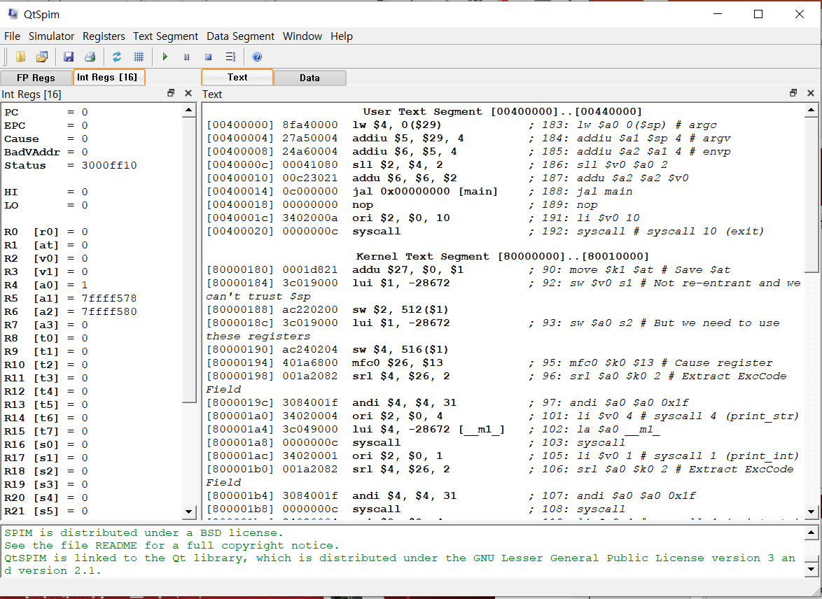
Start SPIM
Program Code
Register visualization
Messages

Slide 4
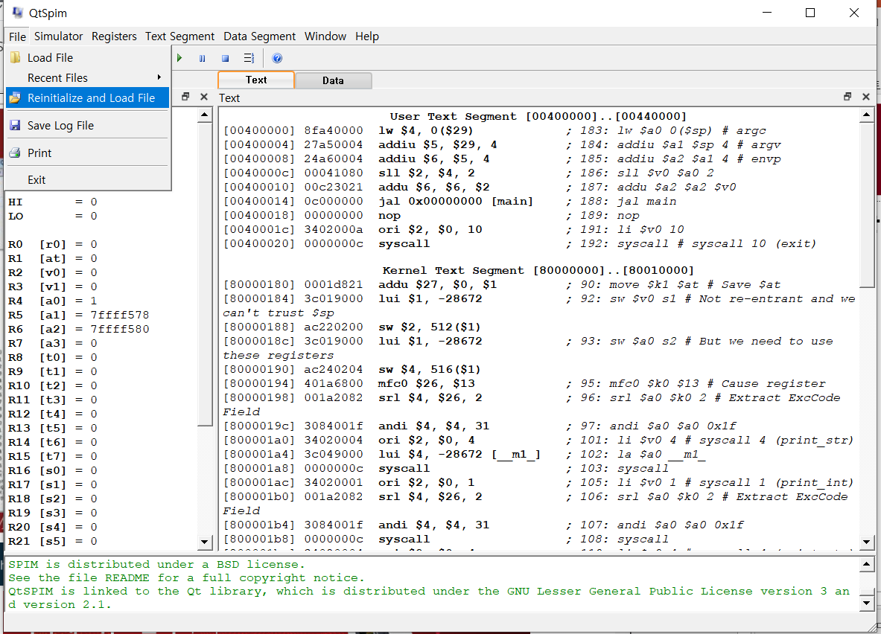
Load Program
Load your assembly code

Slide 5
How to run program
Run the entire code (F5)
Run the code line by line (F10)

Slide 6
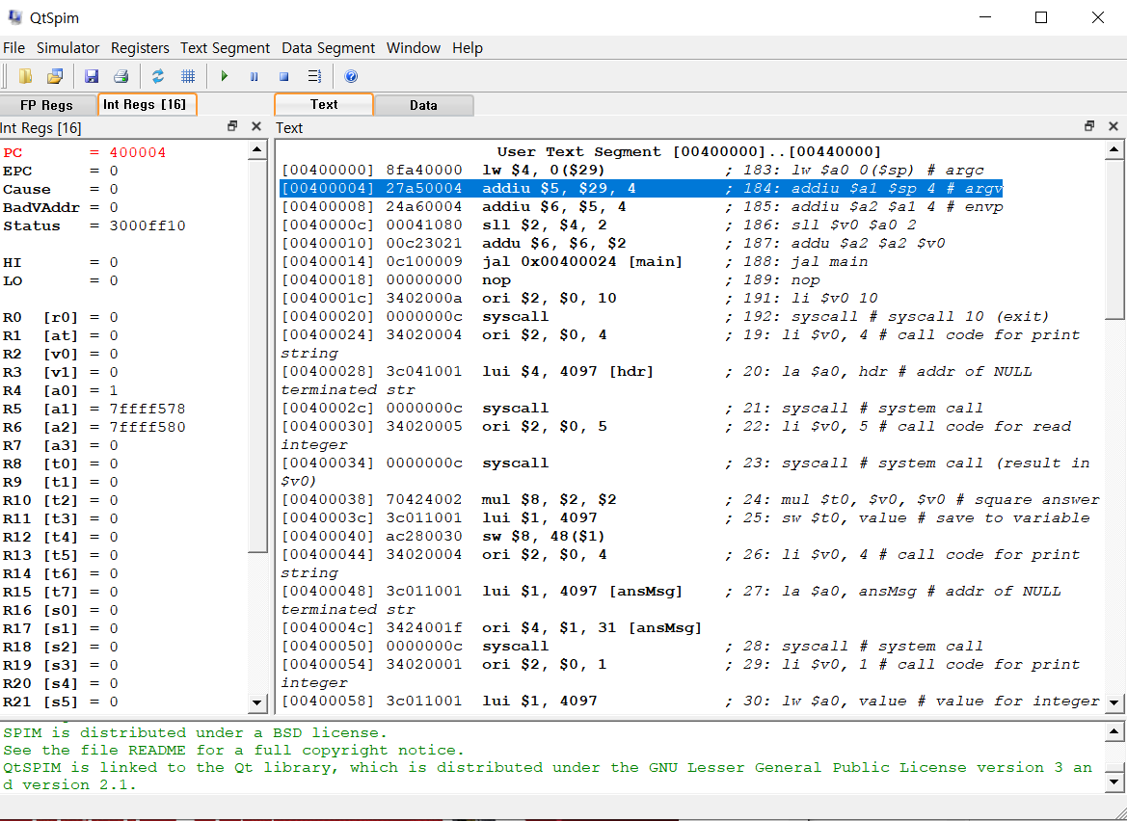
Execute program
Register change resulting from previous instruction
Current instruction

Slide 7
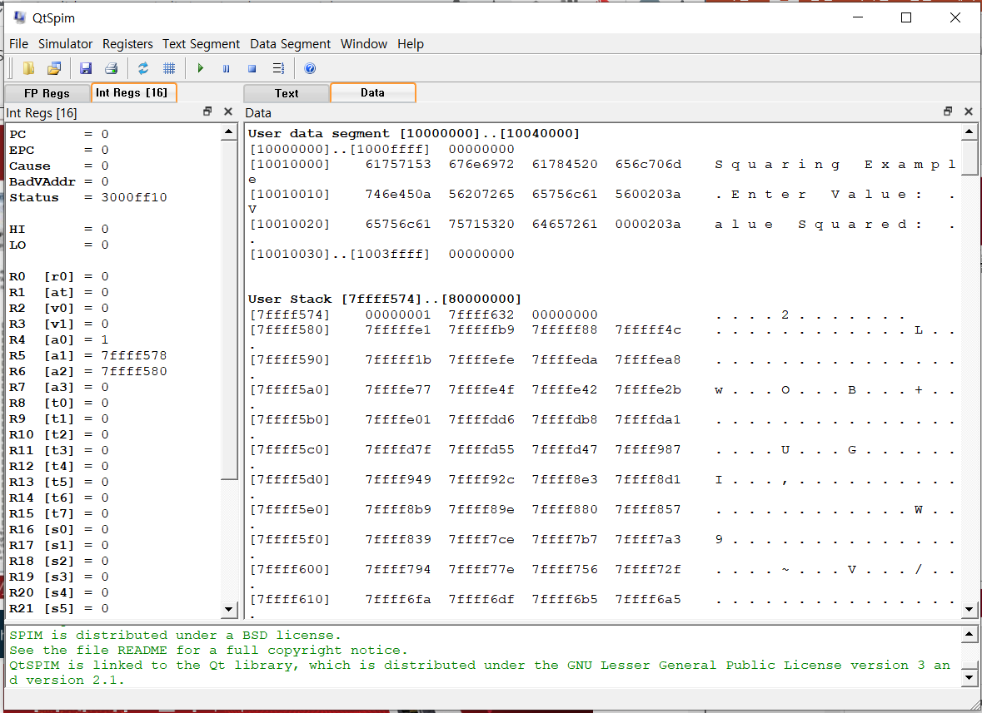
Program data
Program data

Slide 8
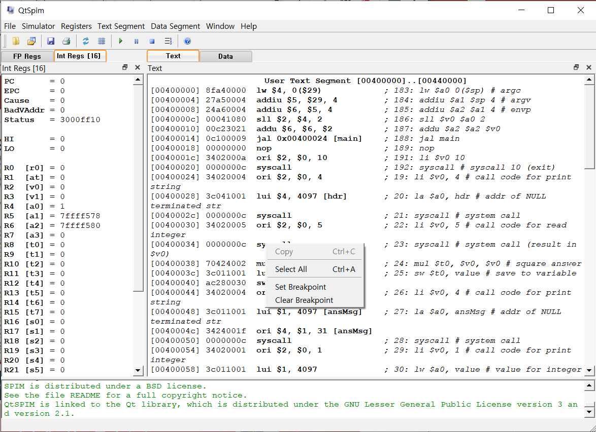
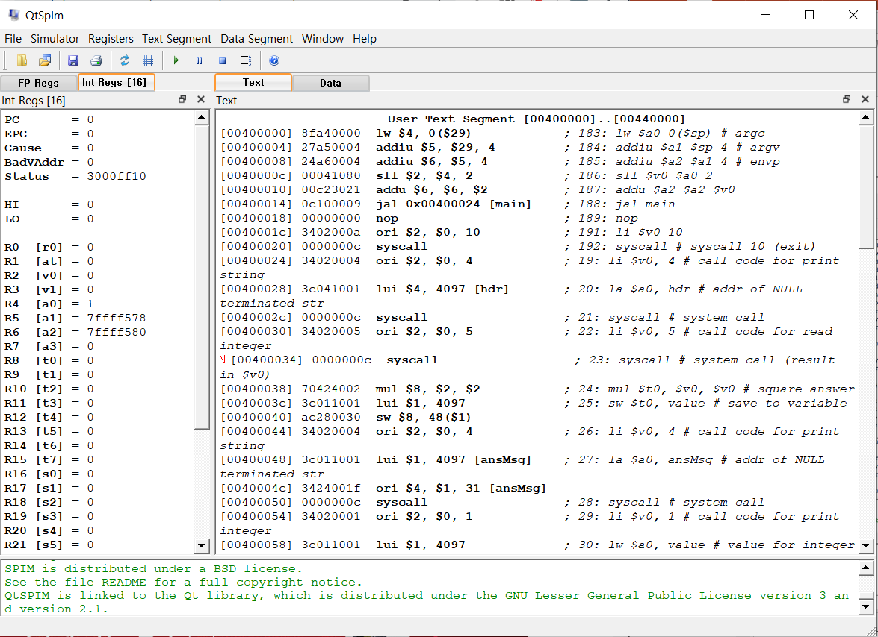
Set a breakpoint
Right click the instruction to set the breakpoint
Breakpoint

Slide 9
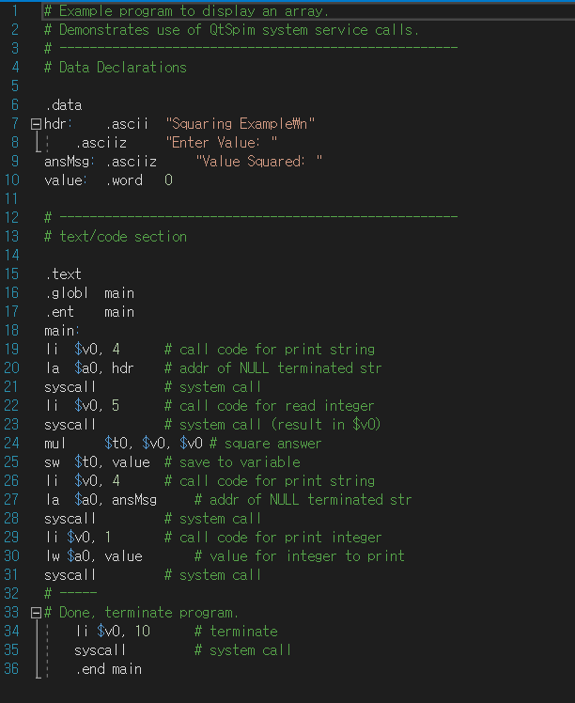
How to write MIPS assembly language programs
Section
The ".globl name" and ".ent name" directives are used to define the name of the initial or main procedure.
Label
Labels are code locations, typically used as a function/procedure name or as the target of a jump.
Must start with a letter
May be followed by letters, numbers, or an "_" (underscore).
Must be terminated with a ":" (colon).
May only be defined once.

Slide 10
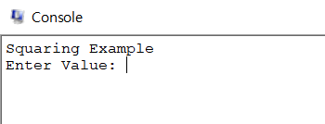
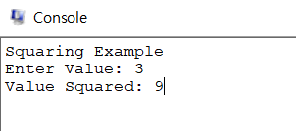
Example - Print and scan
Print ‘hdr’ label
Scan data from console
Square the data and save to ‘value’
Print ‘ansMsg’ label
Print ‘value’
Terminate program

Slide 11
프로젝트 문제
1. 3X3 역행렬
숫자는 아무거나 상관없음(미리 저장 or 실행시킨 후 입력)
2. Heap sort
입력한 숫자가 Heap 의 마지막 노드로 추가가 되고, 즉시 Heap Sort로 내림차순 정렬 후 출력시켜주는 프로그램
입력 예시 1 : 4 출력 예시 1 : 4
입력 예시 2 : 10 출력 예시 2 : 10 4
입력 예시 3 : 7 출력 예시 3 : 10 7 4
입력 예시 4 : 15 출력 예시 4 : 15 10 7 4
입력 예시 5 : 12 출력 예시 5 : 15 12 10 7 4
알고리즘 설명은 아래 사이트 참고https://ratsgo.github.io/data%20structure&algorithm/2017/09/27/heapsort/

Slide 12
What to submit
A code file(.s) : 40%
Include detailed comments inside your code
A WORD/HWP document that describes your algorithm : 60%
File name is same as code file, ex) 학번_이름.xxx
You can use any word processor.
You must explain your code and algorithm in detail.
Your document will be used to determine partial credit if the code fails to run.
Save your files in [student number] folder, and zip.
Follow this example. ex) 학번_이름.zip
Submit your zip file through BlackBoard

Slide 13
Q & A

